Slide 1
SafeEngine
Blended Learning through Innovative Tools for Sustainable and Safety Engineering and Social Inclusion
Project Manager: Conf. Dr. Ing. COCÂRȚĂ Diana
PARTNER: XXXXX
Erasmus+ Programme Key Action 2
Strategic Partnerships

Slide 2
SafeEngine Motto
Building a strong foundation today for enabling engineers to solve the problem of tomorrow

Slide 3
The essence of SafeEngine

Slide 4
Context
SafeEngine is a transnational project designed to develop and share innovative practices and promote cooperation, peer learning, and exchanges of experiences in the field of higher education, designed for engineering higher education sector.

Slide 5
Objectives
Development of innovative tools for engineering higher education sector, supporting the improvement of some learning outcomes-oriented curricula that better meet the learning needs of students, while also being relevant for the labour market and for the wider society.

Slide 6
Project Partners
University Politehnica of Bucharest (Romania) CO-UPB
University of Málaga (Spain), UMA
Univesity “Lucian Blaga” of Sibiu (Romania), ULBS
University Federico II of Naples (Italy) UNINA

Slide 7
What we plan?
Throughout the implementation of the project, we intend to strengthen certain important competencies in the engineering sector.
Partner Universities are preparing courses to share knowledge on 4 important areas:
Occupational health and safety
Safety in process industries
Environmental risk assessment
Social inclusion of peoples with disabilities in the workplace

Slide 8
Project Objectives
SOP 1
Specific Objective I Development and implementation of 4 stackable e-learning modules and practical works
SOP 2
SOP3
Implementing the innovative practices developed in the project through innovative ICT technologies and mutual learning.
SOP4
Dissemination and exploitation of the project results
Specific Objective II Development of best practices, common standards and guidelines for designing e-learning courses
Specific Objective IV
Specific Objective III

Slide 9
Partner responsibilities
All partners work in a coordinated manner to develop the right tools, ensuring that the implemented project will have a great impact on today's engineers

Slide 10
Partner responsibilities
Implementation Plan
Dissemination Plan
Learning, Meetings and Events Plan
Evaluation Plan
CO- University Politehnica of Bucharest
Universidad de Malaga
“Lucian Blaga” University of Sibiu
Universita degli Studi di Napoli Federico II

Slide 11
Achievements

Slide 12
Achieved in Project Implementation
Workshop
SafeEngine Website
v
v
Workplace Social Inclusion, Ocupational Safety and Environmental Risk Assessment, Sibiu (Romania)
Documentation Planning
Important information of the project uploaded online on SafeEngine website
Bases of SafeEngine Project
v
Kickoff Meeting
Documentation Planning
Documentation Planning, confirmations and monthly meetings with partners
Documentation, Project Planning
Partners disscussions and agreements upon dates and each responsibilities throughout the project
Kickoff Meeting
Documentation Planning, confirmations and monthly meetings with partners

Slide 13
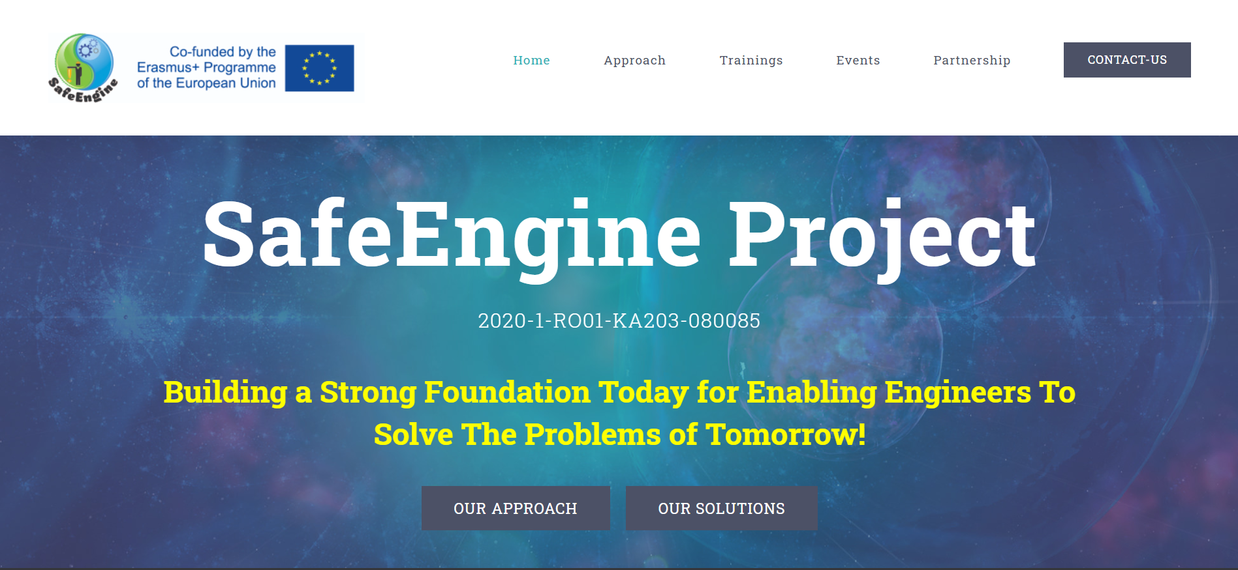
Website presentation

Slide 14
Workshops, Multiplier Events
Trainings held within the project
Partners implicated in the project
Project Presentation, important dates, courses to be enrolled in
Reach out to us via e-mail
Access link safeengine.eu
Our ideas in the engineering education sector
Our solutions to engineers in this evolving society

Slide 15
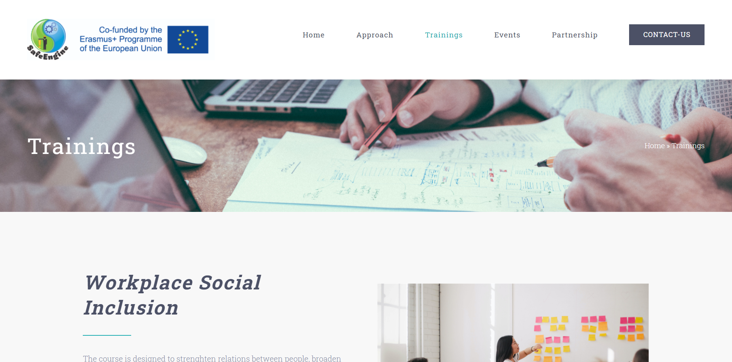
Training Section:
Students have the opportunity to find the courses of their interest and click on the button of pre-registration
Pre-registration form:
It asks for basic student information (email, phone, interests)
What courses would you like to attend.
Suggestions/expectations on the part of the students.
Selection of the students to our courses will be done as follows:
The obtained data from the pre-registration form, students will be contacted accordingly;
Next, students will be invited to submit their CV and Cover Letter;
Last, Interview with our experts.
An unique training session: 1st March 2022- 31st May 2022
By June we will have information of the students that will attend summer school in Naples.
Student target number:
A total of 80 students trained in at least 2 fields from the project
28 in all fields, from UPB, UMA, ULBS, UNINA
Students’ Enrolment

Slide 16
Activity presentation
The course will be organized at least in 5 virtual lessons and 1 practical work
1. Minimum requirement: 2/4 courses
2. After each class attendance, student will be given a short multiple-choice questionnaire, basic information gained from the class presentation.
3. At the end of each virtual lesson, students’ will be given opportunity to sign up for the exams, only if successful passed all the classes. Registration to exams can be done online.
4. If there are students that failed the exam, an automatically diagnostic report will be generated. Based on the report students can study and re-take the exam.

Slide 17
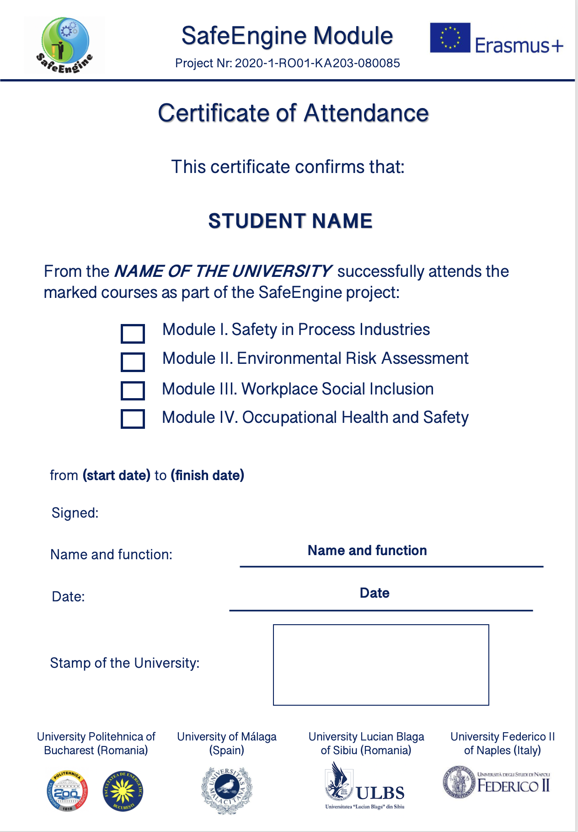
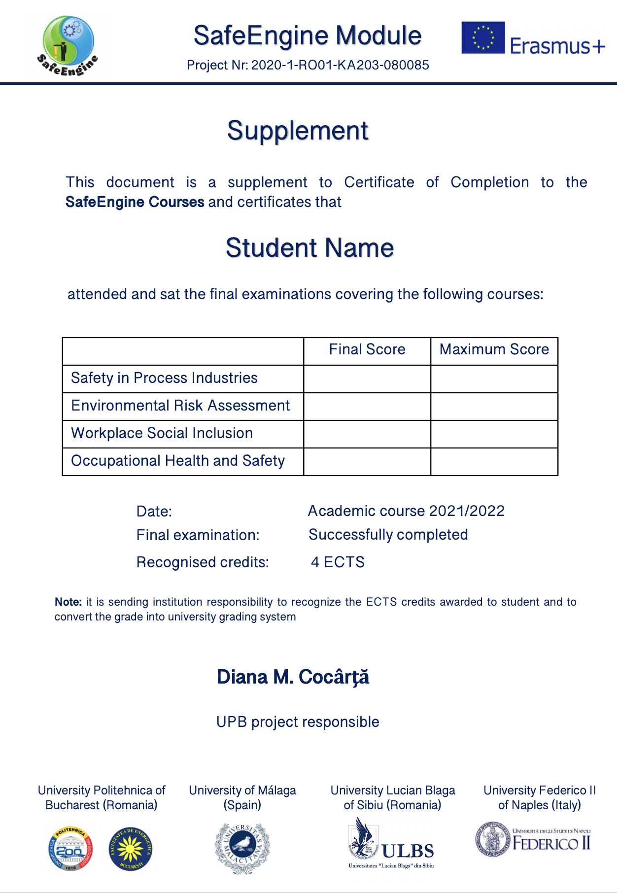
CERTIFICATE OF ATTENDANCE
University Politehnica of Bucharest (Romania) CO-UPB
University of Málaga (Spain), UMA
Univesity “Lucian Blaga” of Sibiu (Romania), ULBS
University Federico II of Naples (Italy) UNINA

Slide 18
LONG-STANDING SUMMER SCHOOL
Sustainable and Safety Engineering and Workplace Social Inclusion
28 students (7 per partner)
June 2022
5 days + 2

Slide 19
Want big impact? Choose SafeEngine

Slide 20
Thank you for your attention

